Slide 1
Review on Simplifying Radicals:

Slide 2
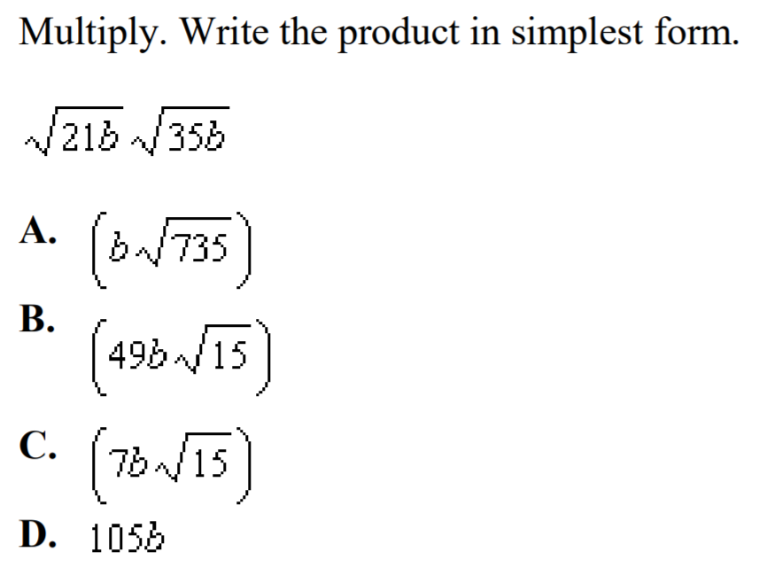

Slide 3
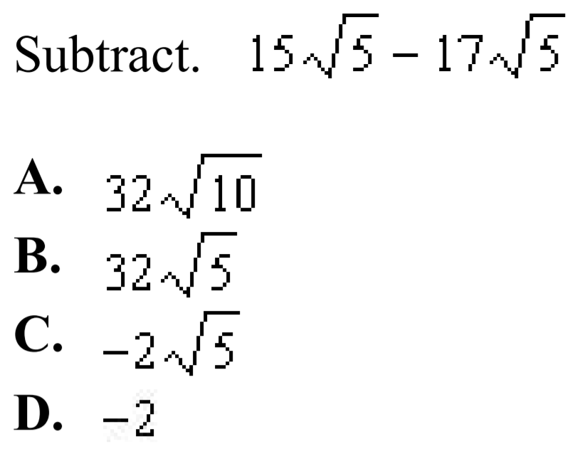

Slide 4
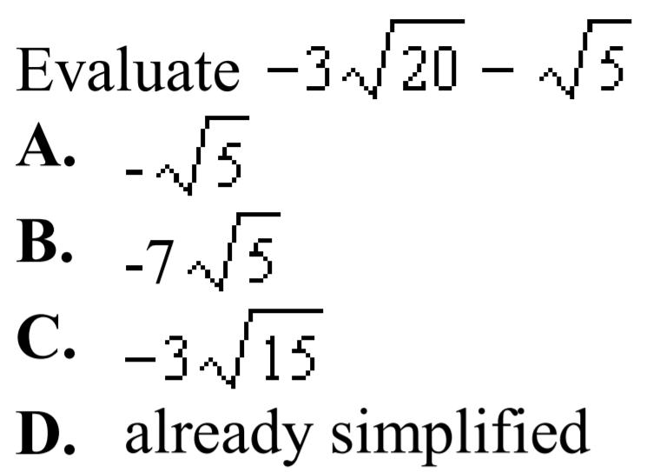

Slide 5
Simplify:

Slide 8


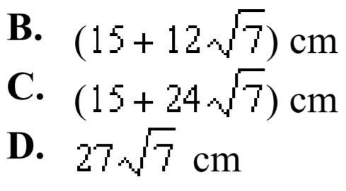

Slide 9
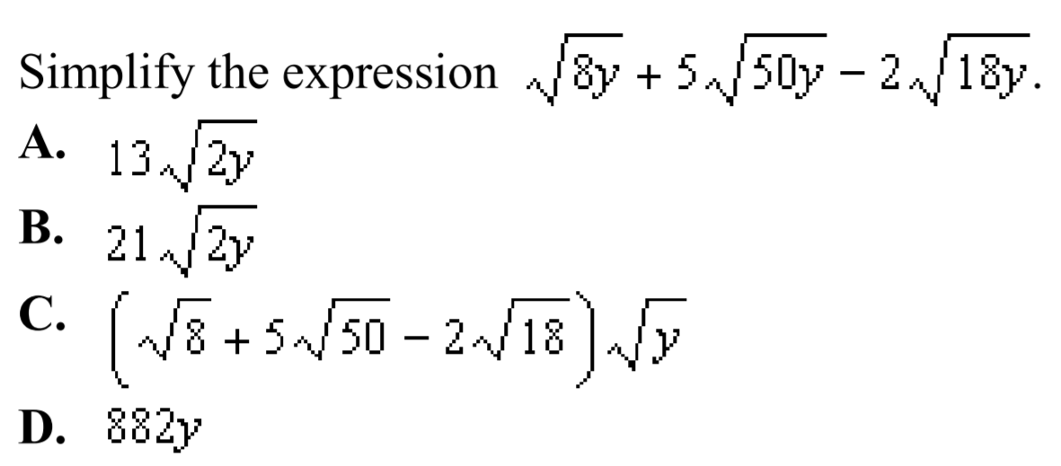

Slide 10
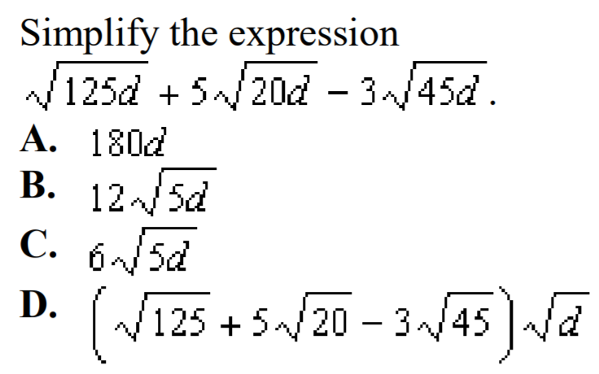

Slide 11


Slide 12


Slide 13

Simplify:

Slide 16


Slide 17


Slide 18
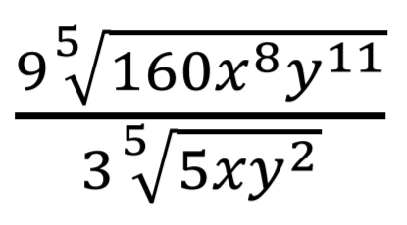

Simplify as a mixed radicals to lowest terms:

Slide 19
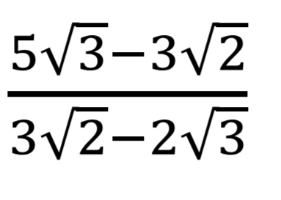
Which of the following is the correct step to rationalizing the expression?

Slide 20
Which of the following is the correct step to rationalizing the expression?

Slide 21
Which of the following is the correct step to rationalizing the expression?

Slide 22
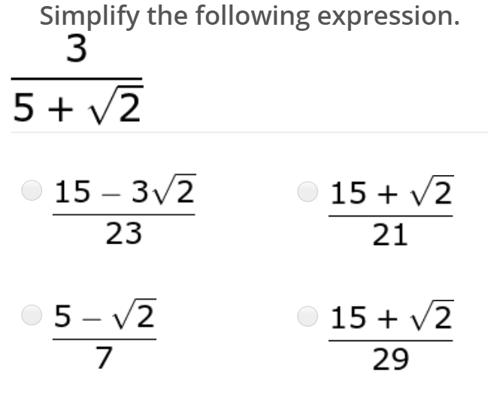

Slide 23


Slide 24

Simplify and Rationalize :

Slide 25
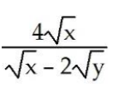
Simplfiy and Rationalize :

Slide 26


